Slide 1

Scope Of Improvements In Hilton App
Tushar Yadav Friday, April 4, 2025

Slide 2
Contents
Executive Summary
Incorrect Location Selection & Currency Inconsistency
Missing Room Images in Selection Flow & Lag in Room Details
Recommendations & Next Steps

Slide 3
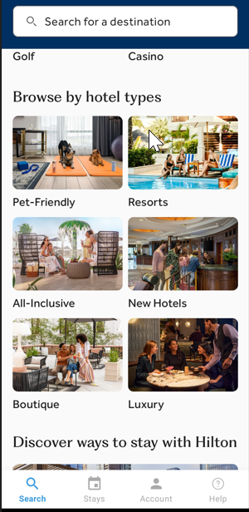
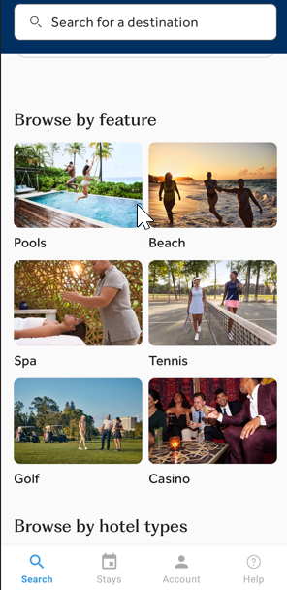
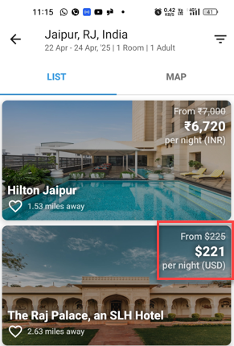
Executive Summary
Issues Identified:
There is room for improvement in the “Browse by Hotel Types” and “Browse by Feature” sections of the app. Currently, selecting any hotel type or feature always shows hotels in North America, with no option to change the location.
When selecting a room, users are unable to see what the room looks like; Details are provided, but no images are attached for the selected room.
In the Room Details section, the sub-sections such as “For Your Comfort,” “For Your Convenience,” and “For Your Confidence” take 1–2 seconds to load after the page opens.
There is inconsistency in the currency used to display prices for different hotels within the same country or state.
Recommendations:
Display hotels and properties based on the user’s default region or GPS/IP address.
Improve room visibility by including representative images and/or short videos for each room type
Standardize currency formatting and allow users to select their preferred currency.
**All observations are for an Android device

Slide 4
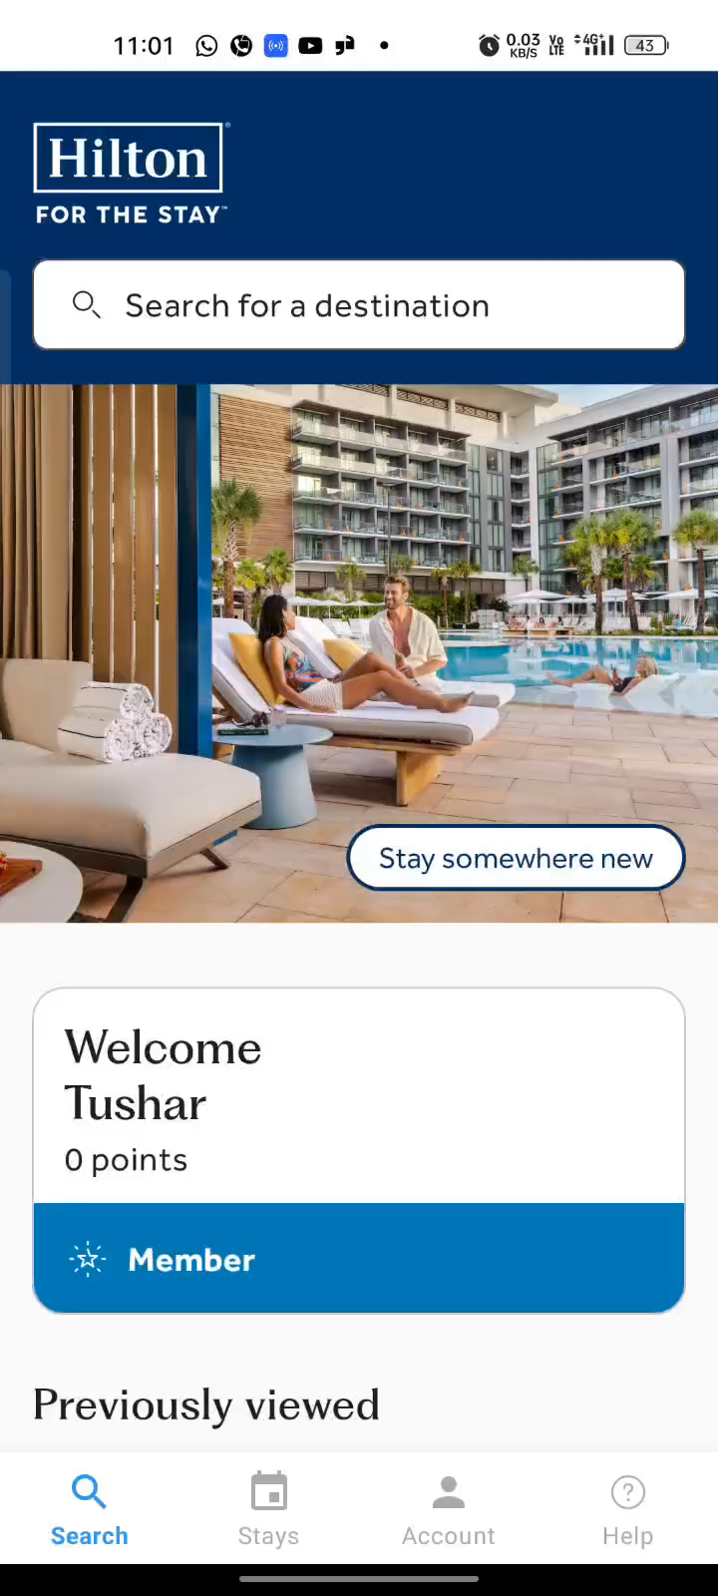
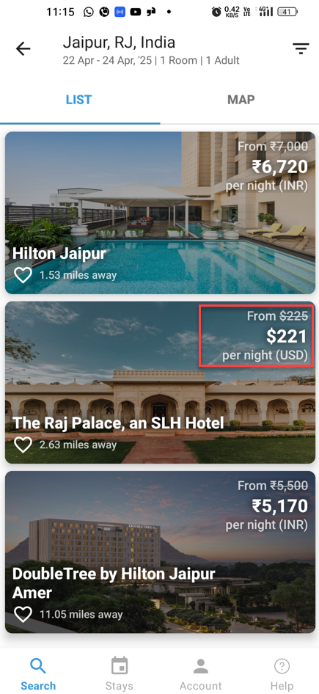
Incorrect Location Selection & Currency Inconsistency
Incorrect Location selection
When selecting any section under “Browse by Hotel Types” or “Browse by Features,” the app consistently displays hotels in North America, with no option to change the location.
This occurs even when location services are enabled on the device.
While there is an option to filter by distance, adjusting this filter still shows hotels located in North America.
This can negatively impact the customer experience, as the app does not reflect the user's actual region leading to unexpected and irrelevant results.
Currency Inconsistency
In a scenario where Jaipur, India was selected as the location, two hotels displayed prices in INR while one showed prices in USD.
There is currently no option for users to select their preferred currency.
This inconsistency can confuse users, leaving them unsure whether the payment will be made in INR or USD, and whether additional charges may apply.
Location inconsistency video
Currency Inconsistency
**All observations are for an Android device

